Slide 1

DS Presentation
districtwise-sll-crimes-2017-onwards
Alakshendra Pratap Singh
Sem: 7th
Under the guidance of
Dr. Piyush Chauhan
Symbiosis Institute of Technology, Nagpur Campus

Slide 2

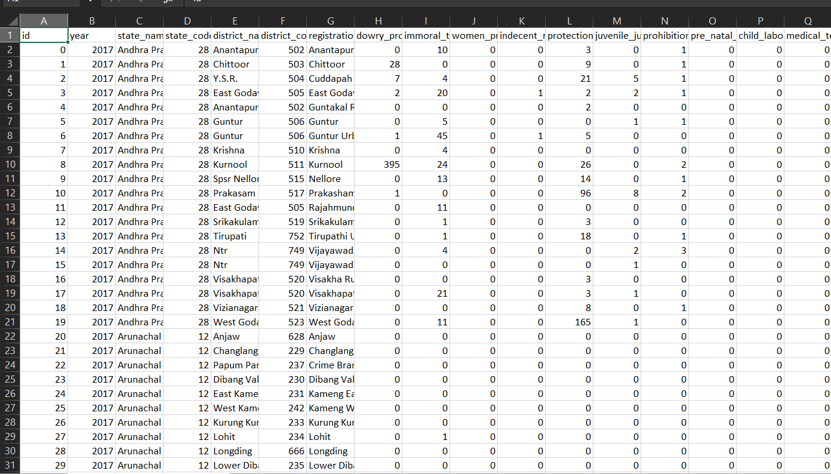
About the dataset
The Dataset: A District-Level View of Crime in India
Source & Scope
Source: National Crime Records Bureau (NCRB), "Crime in India" Report
Content: Crimes registered under Special and Local Laws (SLL)
Timeframe: 6-year period (2017 - 2022)
2. The Key Feature: District-Level Granularity
The data is broken down by District, not just by State.
Why this matters: It allows us to move beyond broad state-level averages and pinpoint specific, localized hotspots.
Structure: District | Year | Crime 1 Count | Crime 2 Count ...
02
04
03

Slide 3
Exploratory Data Analysis (EDA)
EDA: What the Data Told Us
Key Objective: To find hidden patterns and hotspots by correlating 11 key crimes.
2. Key Findings (The "Why" behind the numbers):
Finding 1: The "Compound Crime" Link (Correlation: 0.35)
  What: Immoral Traffic (ITPA) is linked to Child Sexual Offences (POCSO).
  Insight: These are compound crimes (one event, two charges) concentrated in major urban hotspots like Mumbai and Bengaluru.
Finding 2: The "Vice Link" (Correlation: 0.39)
  What: Gambling Act is linked to Excise Act (liquor).
  Insight: A direct operational link, highly concentrated in a few districts, with the Top 5 hotspots all in Madhya Pradesh.
Finding 3: The "Urbanization Effect" (Correlation: 0.41 - 0.47)
  What: IT Act (Cybercrime) is linked to Dowry and Immoral Traffic.
  Insight: A "lurking variable" effect. Urbanization concentrates modern high-tech crime and high-reporting of traditional social crime in the same cities (e.g., Bengaluru).
02
04
03

Slide 4
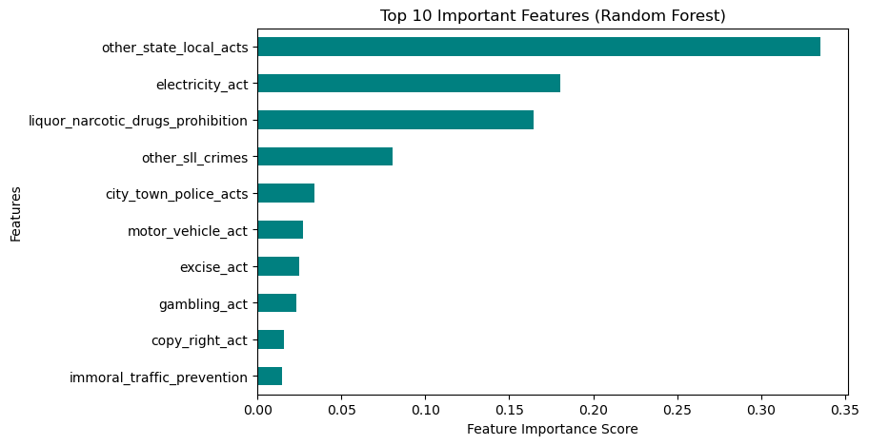
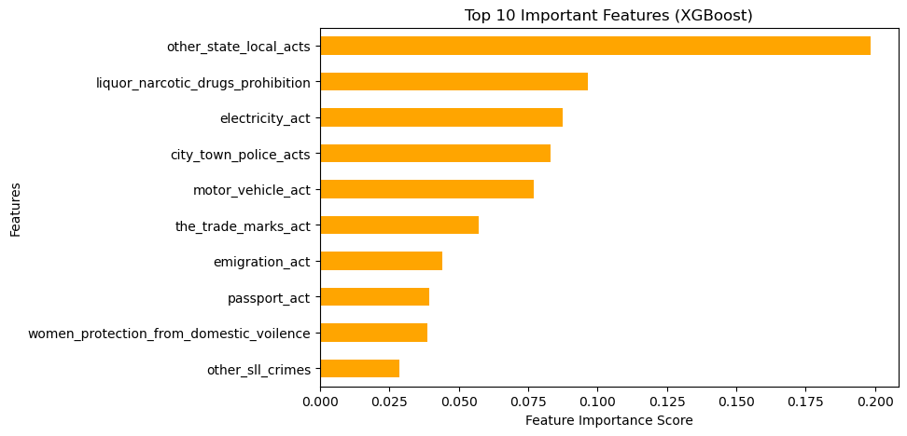
Regression Analysis
1. Goal
To use Random Forest, XGBoost, and LightGBM Regressors to predict the total_crimes value for a district, using the 11 SLL crimes as features.
2. Finding 1: High Accuracy
All three advanced models achieved very high R-squared values (high accuracy).
This confirms that a district's total crime volume is highly predictable from its component crime parts.
3. Finding 2: The Key Insight (Feature Importance)
The most valuable output was the "Feature Importance" report from the models.
All three models unanimously identified other_sll_crimes and motor_vehicle_act as the #1 and #2 most important predictors by a large margin.
Conclusion The total SLL crime burden is overwhelmingly driven by these two high-volume categories. This is a critical insight for allocating police resources, as it shows these two areas contribute most to the overall SLL crime statistics.
02
04
03

Slide 5
Cluster Analysis
1. Objective: Discovering Natural Groups
Our goal was to segment all districts based on their overall crime profile, not just a single crime.
We used unsupervised learning (clustering) to see if clear "types" of districts exist in the data.
2. Methodology & Key Findings
Challenge: The analysis was initially skewed by a few "mega-hotspot" districts with extreme outlier values, which made the clusters unbalanced.
Solution: We first handled outliers using IQR Capping and then scaled all features with a StandardScaler so all crimes were weighted equally.
Method 1 (K-Means): The Elbow Method clearly indicated that K=2 was the optimal number of clusters, showing a sharp "elbow" at that point.
Method 2 (Dendrogram): Hierarchical clustering was used to visually confirm this. The dendrogram showed a clean, high-level split into two main branches, validating the 2-cluster solution.
3. The Two "Crime Profiles" Identified Our analysis successfully identified two distinct district profiles:
Cluster 0: "High Crime Profile"
  A cluster defined by significantly higher rates of "vice" crimes, specifically excise_act and gambling_act.
Cluster 1: "Low Crime Profile"
  A larger cluster of districts with comparatively low and stable crime rates across the board.
02
04
03

Slide 6
Machine Learning: Predicting a District's Profile
1. The Objective: From Insight to Prediction
Our clustering analysis found two distinct profiles. The next step was to use them.
Goal: To build a Supervised Classification Model that can accurately predict whether a new district belongs to the "High Crime Profile" or "Low Crime Profile.“
2. The Methodology: Our Predictive Pipeline
Features (X): The 11 selected crime columns (after being scaled and with outliers handled).
Target (y): The two cluster labels we discovered (e.g., 0 for "Low Profile", 1 for "High Profile").
Process:
  Split Data: We split the dataset (80% for Training, 20% for Testing) to validate our model's performance on unseen data.
  Trained Models: We built and compared two models:
    Logistic Regression: A fast, simple, and highly interpretable baseline model.
    Random Forest: A powerful, advanced model that can find complex patterns.
3. Model Performance & Key Insights
High Accuracy: Both models achieved very high accuracy (over 99%). This confirms that our two clusters are very distinct and can be easily separated and predicted.
Logistic Regression Insights: The model's coefficients showed a clear "push and pull." High excise_act and POCSO rates strongly predicted one class, while high motor_vehicle_act rates predicted the other.
Random Forest Insights (The Key Finding): The "Feature Importance" report told us which features mattered most.
02
04
03

Slide 7
Collaborated Dataset Overview
Overview:
Collaborated with the National Achievement Survey (NAS) dataset obtained from the National Data and Analytics Platform (NDAP) under the Ministry of Education, Government of India. The dataset provides a comprehensive insight into district-level academic performance across India.
Key Details:
Source: NDAP, Ministry of Education
Coverage: 737 districts across 36 States/UTs
Time Period: 2017 – 2021
Dataset Size: 1,405 records (district-year combinations)
Target Classes: Class 3, 5, and 8
Subjects Covered: Language, Mathematics, Science, and Social Science
Purpose of Collaboration:
To analyze learning outcomes, identify regional performance trends, and develop data-driven insights that can guide educational policy and improvement initiatives.
02
04
03

Slide 8
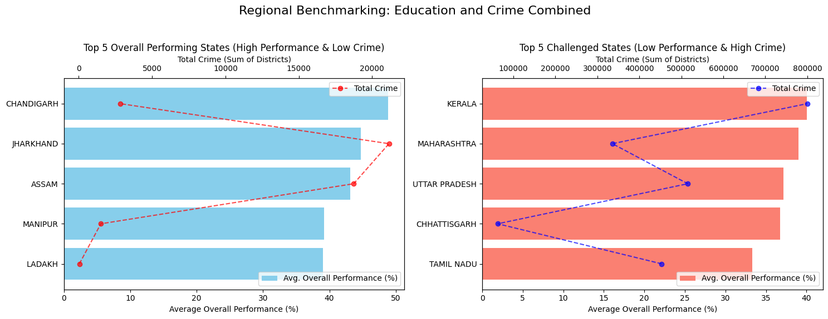
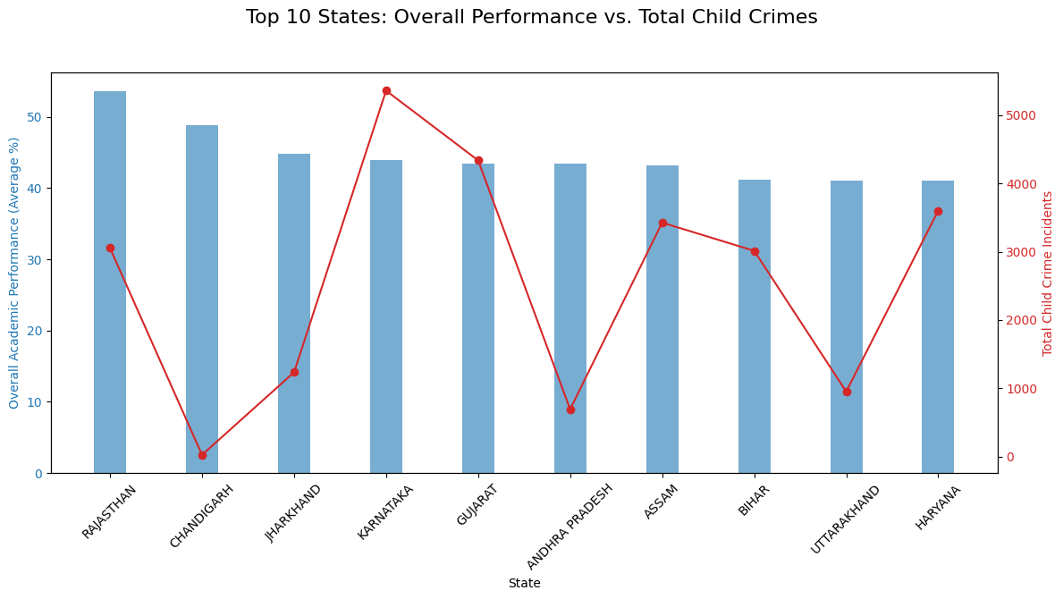
Collaborated Dataset Insights
The chart titled "Top 10 States: Overall Performance vs. Total Child Crimes," focuses on the top 10 states by academic performance (blue bars) and overlays their corresponding Total Child Crime Incidents (red line). States like Rajasthan and Chandigarh lead in academic performance, with Rajasthan also having a relatively high number of child crime incidents, while Chandigarh has one of the lowest in this group. Karnataka stands out with a moderately high academic performance but the highest number of total child crime incidents among the top 10. The visualization reveals a varied relationship, indicating that while high overall academic performance is the common criterion for selection, it does not consistently correlate with low total child crime incidents across these specific top-performing states.
02
04
The chart titled "Regional Benchmarking: Education and Crime Combined," presents a comparison of states across two groups: Top 5 Overall Performing States (High Performance & Low Crime) and Top 5 Challenged States (Low Performance & High Crime). The "Top 5 Performing" states/UTs, like Ladakh and Chandigarh, show high average overall performance percentages (blue bars) coupled with significantly lower Total Crime (red dots and line, measured as the sum of districts' crime). This indicates a positive correlation where strong educational performance coexists with lower crime rates in these regions. Conversely, the "Top 5 Challenged" states, such as Kerala and Maharashtra, exhibit lower average overall performance (red bars) paired with extremely high Total Crime (blue dots and line), suggesting an inverse relationship in this group, with lower educational performance being associated with much higher crime figures.
03

Slide 9
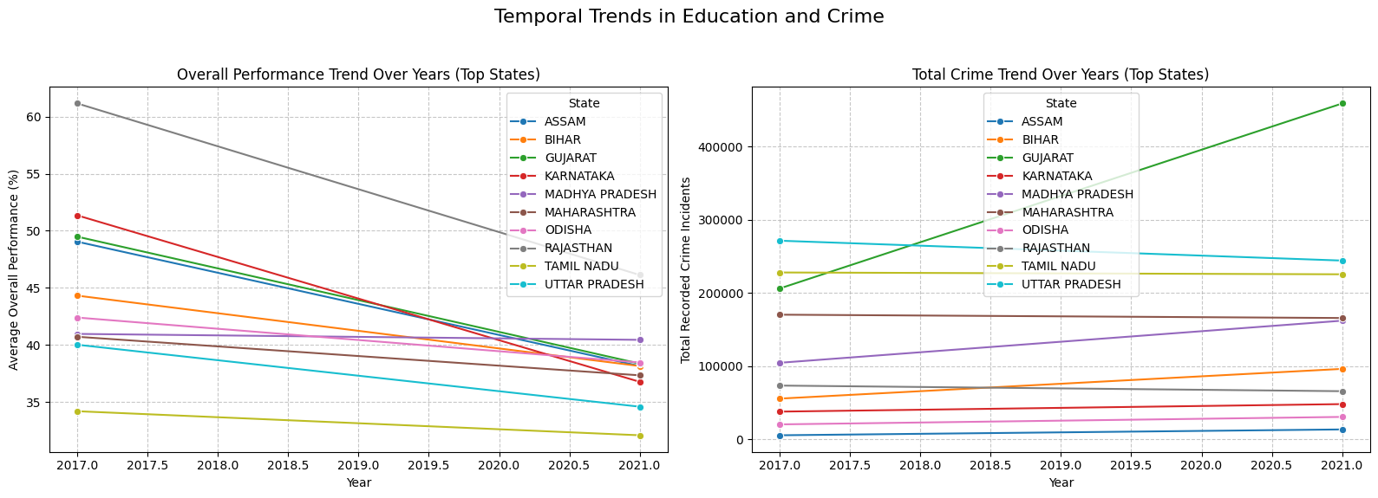
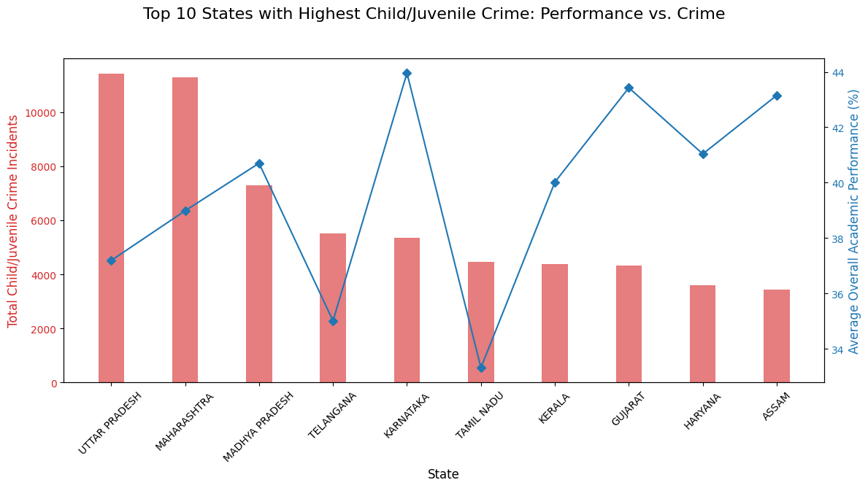
Collaborated Dataset Insights
The second chart, "Top 10 States with Highest Child/Juvenile Crime: Performance vs. Crime," compares the absolute number of Child/Juvenile Crime Incidents (red bars, primary y-axis) with the Average Overall Academic Performance percentage (blue line, secondary y-axis) for the ten states with the highest child crime. States like Uttar Pradesh and Maharashtra lead in the highest volume of child/juvenile crime incidents. The chart reveals a highly inconsistent relationship between the two metrics. For instance, Karnataka and Gujarat show relatively high overall academic performance percentages (peaks in the blue line) despite also being in the top 10 for child crime, with Karnataka's academic performance being the highest. Conversely, Tamil Nadu and Assam have lower academic performance percentages.
02
04
The graph titled "Temporal Trends in Education and Crime," illustrates changes in Overall Performance (left chart) and Total Crime (right chart) for a selection of top states over a five-year period (2017 to 2021). The left chart shows a universal declining trend in the Average Overall Performance percentage for all listed states, with Rajasthan and Madhya Pradesh starting at the highest levels and experiencing significant drops, while Tamil Nadu maintains the lowest but most stable performance. Conversely, the right chart, which tracks Total Recorded Crime Incidents, shows a general increasing trend or stability for most states. Notably, Madhya Pradesh experiences the most dramatic increase in total crime over the period, while states like Assam and Gujarat also show clear increases. This contrast highlights a potential inverse relationship across the analyzed states: as educational performance generally falls, crime rates generally rise or remain high.
03

Slide 10
02
Thank You
04
03

